Slide 1
Computer Networks EDA387/DIT663
CHALMERS and University of Technology
Computer Science and Engineering Networks and Systems
Fault-tolerant Algorithms for Computer Networks
Self-stabilizing Software Defined Networks
(Based on slides prepared by Iosif Salem)

Slide 2
Goals
The review and understand software defined networks (SDNs).
To understand Renaissance [1].
To prepare for a lab on Renaissance.
[1] Marco Canini, Iosif Salem, Liron Schiff, Elad Michael Schiller, Stefan Schmid, ``Renaissance: A Self-Stabilizing Distributed SDN Control Plane’’ 38th IEEE International Conference on Distributed Computing Systems (ICDCS) 2018: 233-243

Slide 3
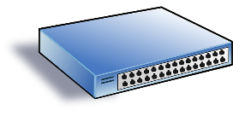




In a nutshell
Software-Defined Network control plane
Distributed and in-band
Tolerating:
Node/link failures
Arbitrary failures
For detailed review, cf. lesson 11 at Computer Networking (Georgia Tech)

Slide 4
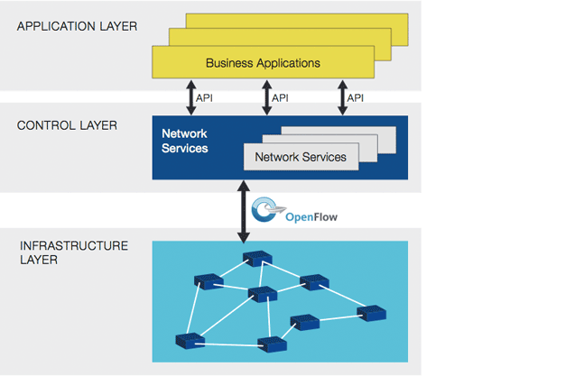
Why Software-Defined Networks (SDN)?
Application demands from the network
Decision making: Computing/Installing packet forwarding rules, local computations
Packet forwarding,
statistics
Image: Open Networking Foundation

Slide 5
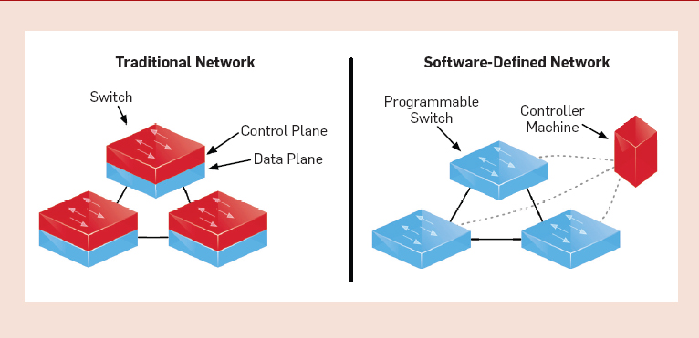
Separation of Control and Data Plane

Slide 6
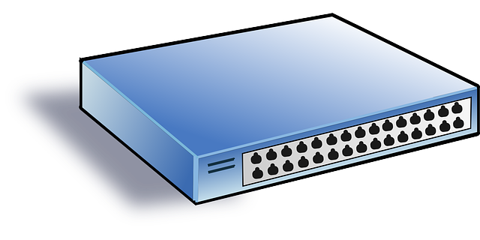
SDN switch
A switch can
Receive control-traffic by a managing controller, e.g., including packet-forwarding rules.
Forward packets based on matching rules in its flow tables = forward table
A rule includes a source, destination, and action field: when a packet matches the source and destination of a rule, the switch takes the rule’s action (forward to a neighbor)
A rule may include also priority and metadata fields
Keep network statistics (for the controller)
Respond to controller queries
Notes:
More info: https://youtu.be/l25Ukkmk6Sk

Slide 7
SDN controller
A controller (network-attached server) can
manage switches
Ask for network statistics
Access switch local storage
Packet-out (response to packet-in), flow-MOD (install/modify rules, modify switch buffer)
do local computations
Re-compute network flows based on statistics (counters on switches)
Compute packet-forwarding rules for each switch they manage
Install flows, by updating packet forwarding rules
Rule updates are not trivial (loop-free updates NP-complete*)
*Scheduling Loop-free Network Updates: It's Good to Relax! Arne Ludwig, Jan Marcinkowski, Stefan Schmid. PODC '15

Slide 8

OpenFlow
This protocol enables access to the switch forwarding plane.
The controller uses OpenFlow for determining the flow of packets across the network of switches.
By separating the control from the packet switching a more elegant network management facilitated than using access control lists and routing protocols.
OpenFlow allows remote administration of a layer 3, by adding, modifying and removing packet matching rules and actions.
Packets which are unmatched by the currently installed switch rules are forwarded to the controller; this is the PacketIN event.
The controller can then decide to modify existing rules (Flow-MOD), and/or
modify the arriving packet before releasing it (Packet-OUT).

Slide 9
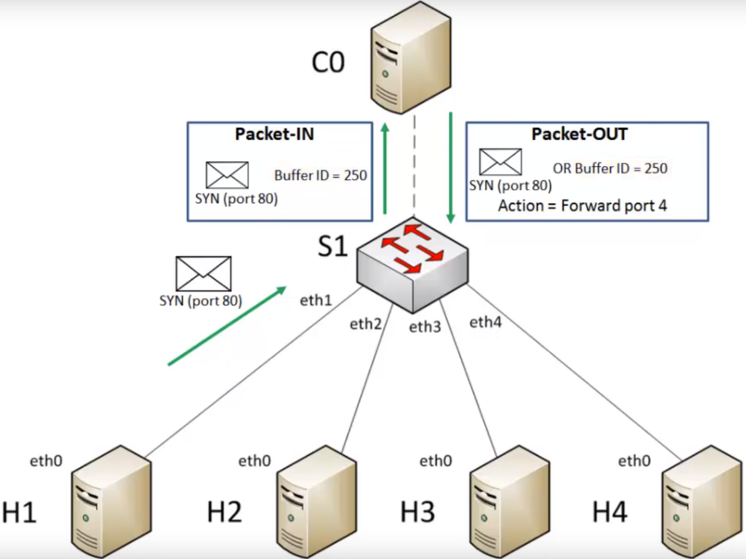

Slide 10
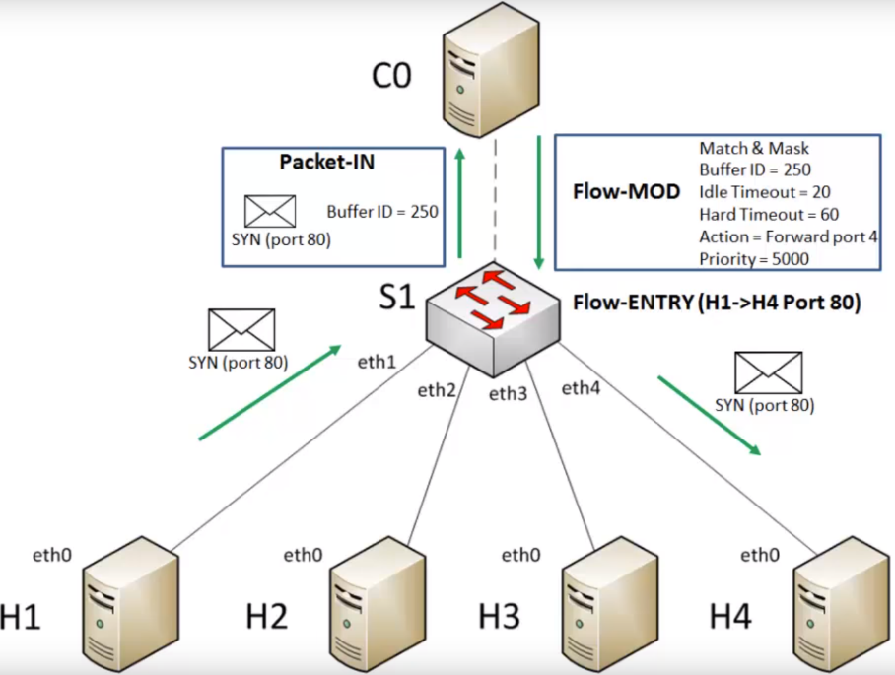
Notes:
https://youtu.be/l25Ukkmk6Sk?t=2m38s

Slide 11
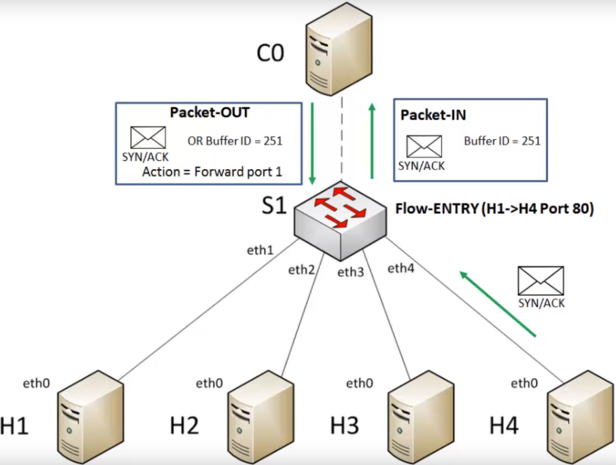

Slide 12
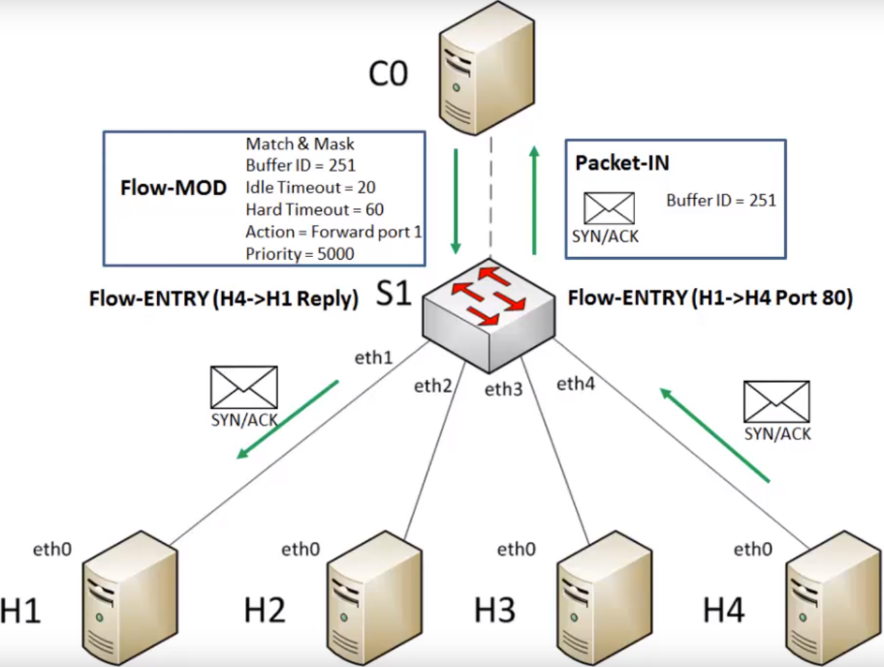

Slide 13


Slide 14
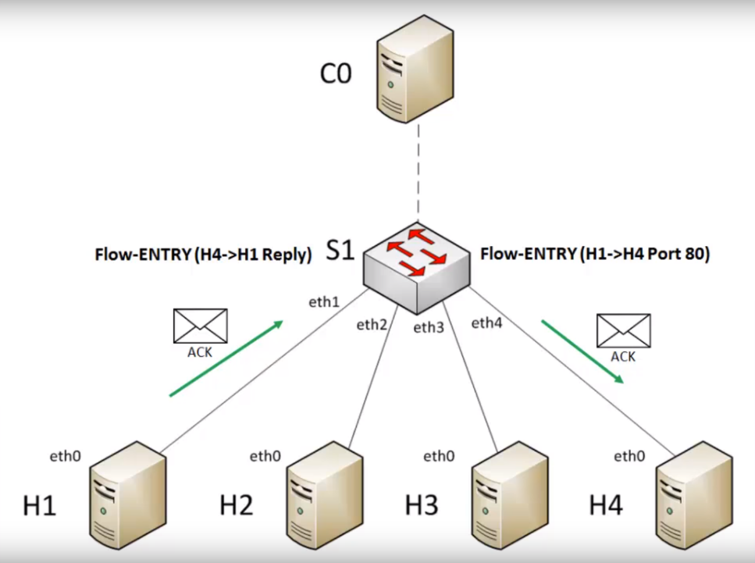

Slide 15
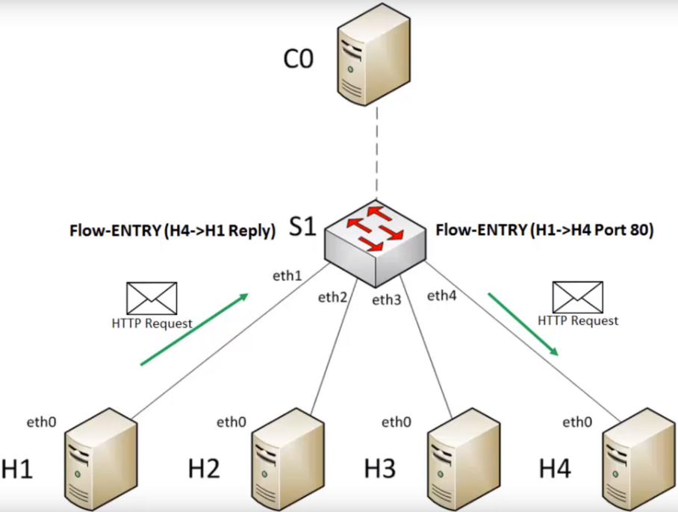

Slide 16
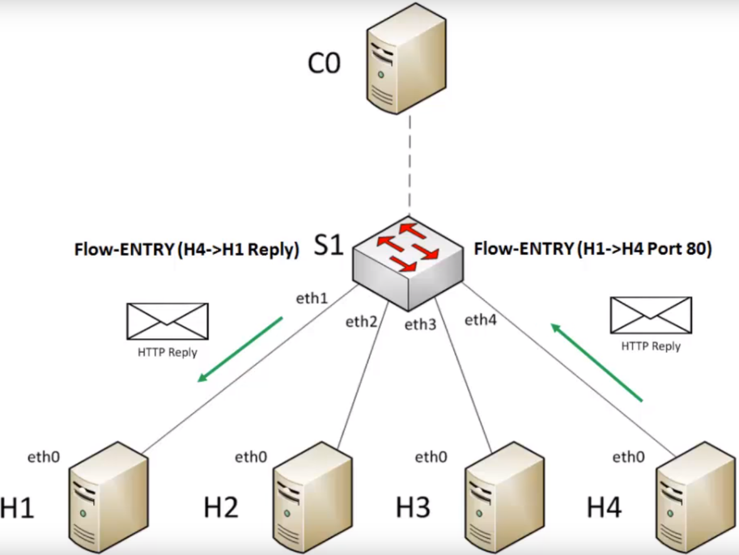

Slide 17
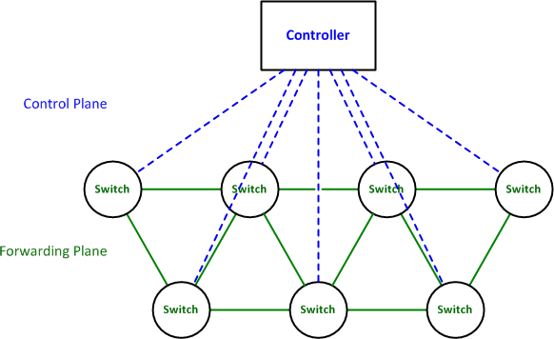
Out of Band Control Plane
Logically centralized, and possibly physically distributed:
Reliability
Availability
Scalability
Low latency
Out-of-band SDN control: Physically/logically separate network acts as the controller entity
Image: packetlife.net
Notes:
Out-of-band:
Used in most SDN deployments in practice (so far)
Management network runs its own routing system, typically realized using traditional routing protocols such as STP or OSFP

Slide 18
In-band SDN control
Control traffic
through dedicated management port (Controller A)
multiplexed with data-plane traffic (Controller B)
Benefits: less cost, higher redundancy, increased partition tolerance

Slide 19
Problem: Distributed & In-band Software-defined network control in the presence of failures
Establish bounded communication delays from every controller to every other node, assuming
no out-of-band control
fail-stop node/link failures
at most K concurrent temporary link failures
transient faults
Only controllers can compute!
Switches can only store rules
failures
Stale forwarding rules

Slide 20
Self-stabilizing systems
Bounded recovery after the occurrence of an arbitrary combination of failures
benign failures: transient link failures and permanent link/node failures.
transient faults: arbitrary violation of the system’s assumptions
as long as the algorithm’s code stays intact (سالم)
System execution
Arbitrary starting configuration
Recovery
Legal execution (tasks are fulfilled)
Notes:
brief

Slide 21
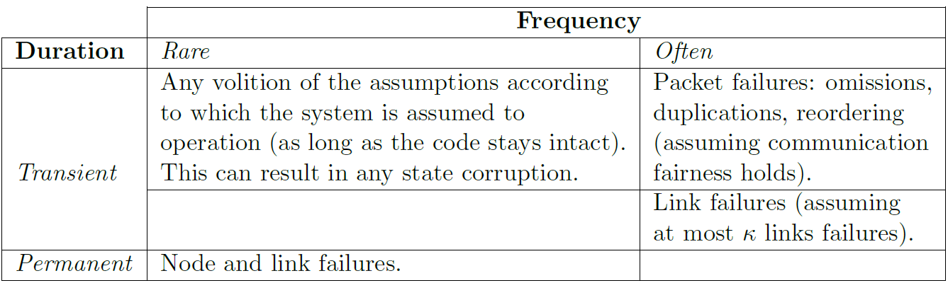
Fault Model
Legal Execution
Prior to the system start, consider all faults
Recovery Period
Consider only non-transient faults
Consider only benign faults

Slide 22

Roadmap
Algorithm
Proof highlights
Evaluation

Slide 23
Roadmap
Algorithm
Proof highlights
Evaluation

Slide 24


Renaissance: Self-Stabilizing, distributed, in-band control plane
Challenge: discover the network topology
Solution: repeatedly query discovered nodes about their local topology (BFS discovery)
is my neighbor
2
1
3
4

Slide 25
Renaissance: Self-Stabilizing, distributed, in-band control plane
Challenge: clean up switch memory from stale information
Solution: repeatedly use query responses, compute updates locally, push to switches
Updates include alternative paths, tolerating up to K concurrent link failures
Query response
update
Notes:
Ok for 1 ctrl. But for more than 2…

Slide 26
Renaissance: Self-Stabilizing, distributed, in-band control plane
Challenge: avoid two controllers removing each other’s updates
Solution:
use synchronization rounds
round ends when topology is re-discovered
when round ends, remove failing controller info from switches
rem ctrl
update
illegitimate deletion
Notes:
Upd: eg install fwd rules

Slide 27
Roadmap
Algorithm
Proof highlights
Evaluation

Slide 28
Self-Stabilizing Distributed SDN Control Plane
Algorithm sketch for controller p_{i}
keep a set of responses for each discovered node
curr and prev synchronization round tags
do-forever
remove stale responses (unreachable nodes)
if topology is discovered then start new synch round
for each reachable switch p_{j} do
if new round started then remove unreachable controller info
update p_{i}’s info (manager set an rule set) on p_{j}
for every node p_{k} do query p_{k} and send updates if p_{k} is a switch

Slide 29
Proving bounded recovery period
Can also tolerate topological changes after recovery in O(maxDiameter)
We show:
Bounded memory requirements
Switch: O(#controllers(#controllers + #switches))
Controller: O(#controllers + #switches)
Bounded number of illegitimate deletions: (c’•maxDiameter + 1)
If no illegitimate deletions, transient fault recovery within (c”+2)•maxDiameter comm rounds
Recovery within: ((c”+2)• maxDiameter + 1) • [#illegitimateDeletions • #switches + #controllers + 1] = O(maxDiameter² • #nodes) rounds
#nodes = #controllers + #switches
Notes:
To do: Write here exact memory bounds and exact constants

Slide 30
Bounded number of illegitimate deletions
Wipe controller memory if bounds exceeded
FIFO updates of switch memories
Proof by induction on distance k-neighbors from each controller:
Within (ck+1) rounds: no illegitimate deletions for at most distance k-neighbors
c: constant – depends on link capacity
k = maxDiameter
1
1
Distance-(maxDiameter)
Distance-k

Slide 31
Bounded number of illegitimate deletions
Intuition: at the k-th roundtrip a controller discovers nodes of distance k+1
k=1: controller knows distance 1 topology – 1 roundtrip for query return
k to k+1: when query from distance-k neighbor returns, controller learns about distance k+1 neighbors

Slide 32
Recovery from transient faults, in the absence of illegitimate deletions
Transient fault recovery, proof by induction on distance-k neighbors:
If no illegitimate deletion, within (c’+2)k rounds:
correctness for at most distance-k neighbors
c’: constant – depends on link capacity
k = maxDiameter
1
Distance-(maxDiameter)
Distance-k

Slide 33
Recovery from transient faults, in the absence of illegitimate deletions
k=1: first roundtrip is for the query, second is for installing the correct state
k to k+1: as in base case
If illegitimate deletion: switch has again an incorrect state!

Slide 34
Bounded number of illegitimate deletions
Wipe controller memory if bounds exceeded
FIFO updates of switch memories
Proof by induction on distance k-neighbors from each controller:
Within (ck+1) rounds: no illegitimate deletions for at most distance k-neighbors
c: constant – depends on link capacity
k = maxDiameter
1
1
Distance-(maxDiameter)
Distance-k

Slide 35
Recovery from transient faults, in the absence of illegitimate deletions
Transient fault recovery, proof by induction on distance-k neighbors:
If no illegitimate deletion, within (c’+2)k rounds:
correctness for at most distance-k neighbors
c’: constant – depends on link capacity
k = maxDiameter
1
Distance-(maxDiameter)
Distance-k

Slide 36
Roadmap
Algorithm
Proof highlights
Evaluation
Done on a PC, using Mininet, and testing standard SDN topologies such as Clos, B4, and Rocketfuel networks (Exodus, Telstra, Ebone)

Slide 37
Setup
PCs with Ubuntu 16.04.1 OS, Intel Core i7-2600K CPU at 3.40GHz (8CPUs) with 16GB RAM.
1 controller req or flow installation per second paths according to BFS OpenFlow fast-failover groups for backup paths
Hosts for traffic and RTT (round-trip delay time) evaluation are placed such that their distance is max
Standard SDN topologies (B4, Clos, Rocketfuel networks). B4 and Clos 3 controllers, Rocketfuel up to 7 controllers, up to ~200 nodes in total.

Slide 38
How efficiently can Renaissance bootstrap an SDN?
Bootstrap time: Empty switch configuration to legitimate state
bootstrap time reduces when reducing query and network update interval, until saturation
bootstrap time is proportional to network diameter
4-5 seconds for all tested topologies
Time (seconds)
Bootstrap time for Rocketfuel networks using 7 controllers, as a function of query intervals
Query and network update interval (seconds)
Notes:
Evaluation done on a PC using mininet and testing standard SDN topologies such as Clos, B4, and Rocketfuel networks

Slide 39
How efficiently does Renaissance recover in the presence of link and node failures?
Legitimate state link/node failure Legitimate state
 | Recovery after failure (seconds)
#controllers (topology) | 1 controller failure | 1-6 controller failures | 2-6 permanent link failures
3 controllers (B4, Clos) | ~ 3.5 to 5 seconds | - | ~ 3.5 to 5 seconds
7 controllers (Rocketfuel networks) |  | ~ 4 to 5 seconds
Recovery time roughly linear in the number of nodes
Diameter affects time to recover to a small extent
Notes:
Do forever loop every second

Slide 40
Throughput and message loss upon link failure
Mbits/s
Time (seconds)
Link failure in primary path:
Throughput drop roughly from 900 Mbits/s to 750 Mbits/s for 2 seconds
Avoid further drop by packet tagging and forcing traffic through alternative paths
Notes:
LE -> link failure -> LE || zig zag due to congestion control

Slide 41
Wrap-up
Self-stabilizing, distributed, in-band, control of software-defined networks in the presence of failures
Deal with concurrent updates of switches
Bounded recovery from topological/comm. failures, transient faults
Future directions:
Combination of in-band and out-of-band control
Consider data traffic dynamics when constructing backup paths

